Slide 1
Hashtag nodes
User nodes
Bipartite network
3 different network architectures
Two hashtags are connected if the same user referenced them.
Link weight is given by the nr of different users who used the hashtag pair.
Two users are connected if they referenced the same hashtag.
Link weight is given by the nr of different hashtags shared between user pairs
Each user connects to the hashtags it referenced.
Users do not connect directly to other users; hashtags do not connect directly to other hashtags.
Link weight between user and hashtag is given by the nr of times a user referenced the hashtag.
Hashtags only used once were removed (trimmed).
2 datasets
_9 noviembre_<
_No al tarifazo_
Networks were created in 1h windows with the raw datasets (before cleaning) and after lower casing and removing all special characters from hashtags (after cleaning).

Slide 2
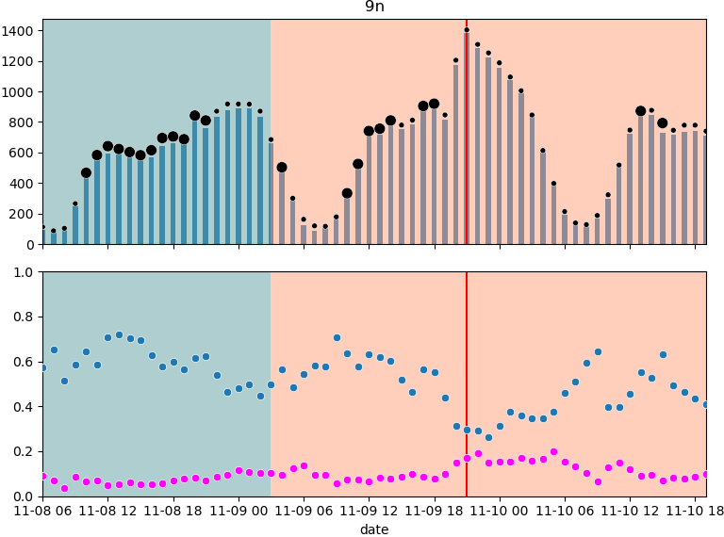
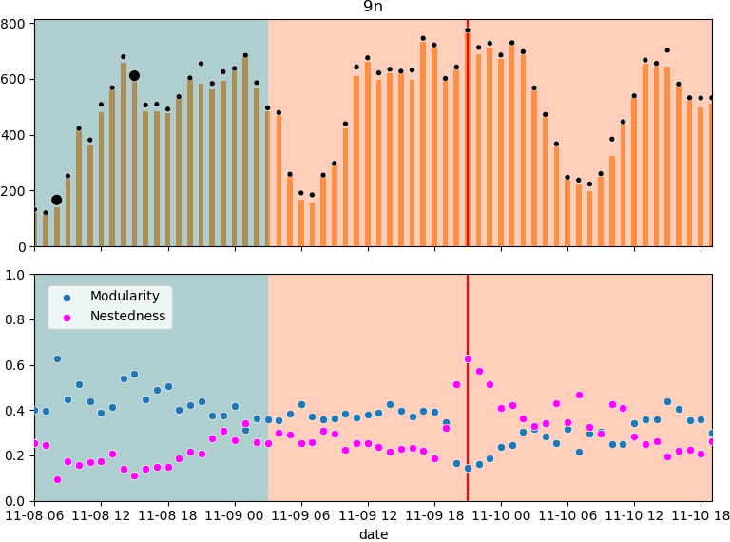
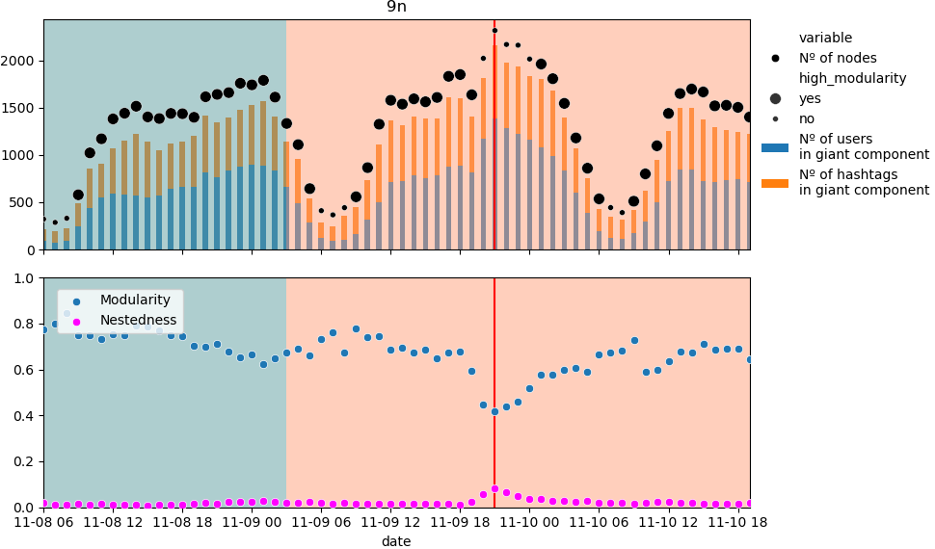

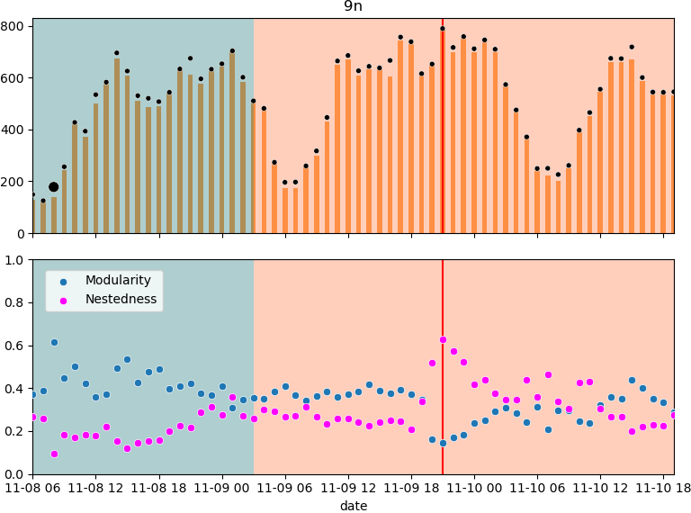
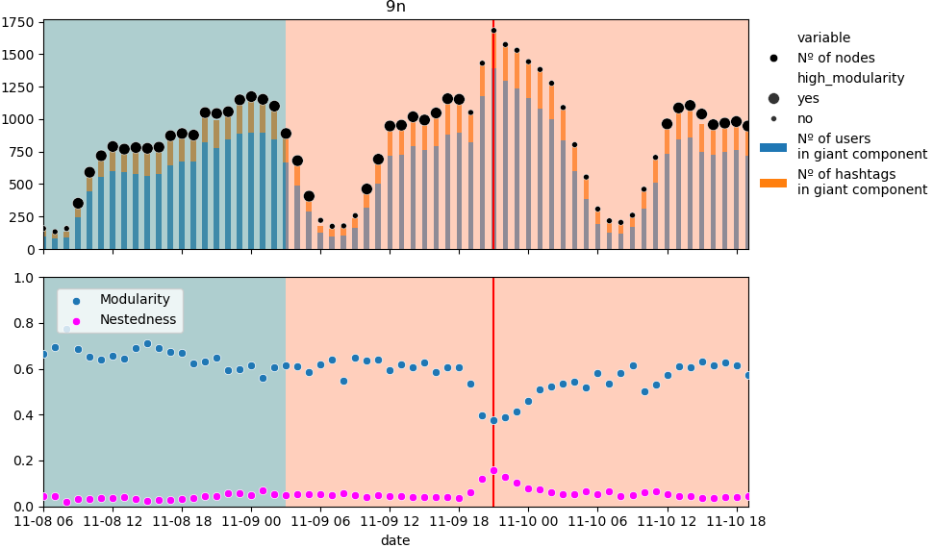
_9 noviembre_
Before dataset cleaning
Hashtag nodes
User nodes
Bipartite network
After dataset cleaning
High modularity defined by modularity >0.55 and
nr. of nodes in network at least 20% of maximum network size
Hashtag nodes
User nodes
Bipartite network

Slide 3
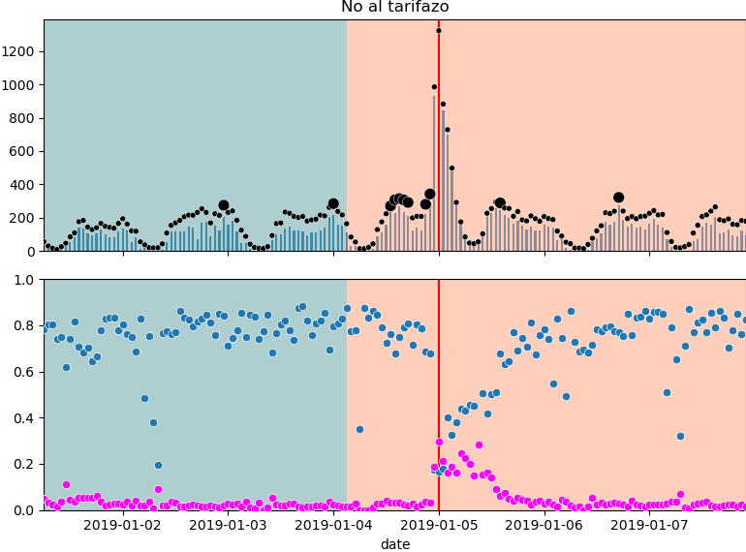
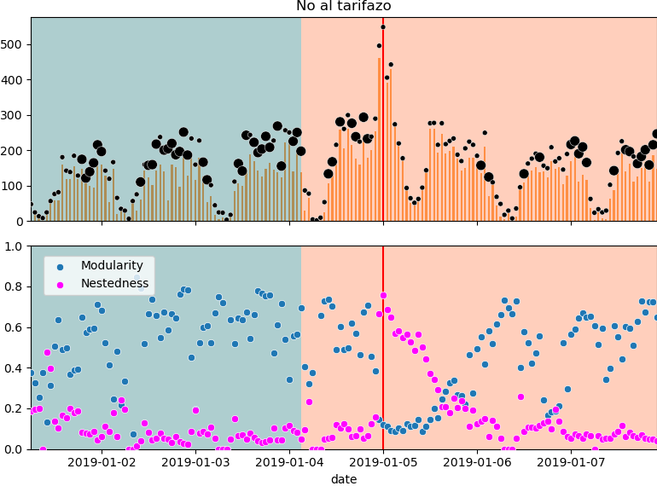
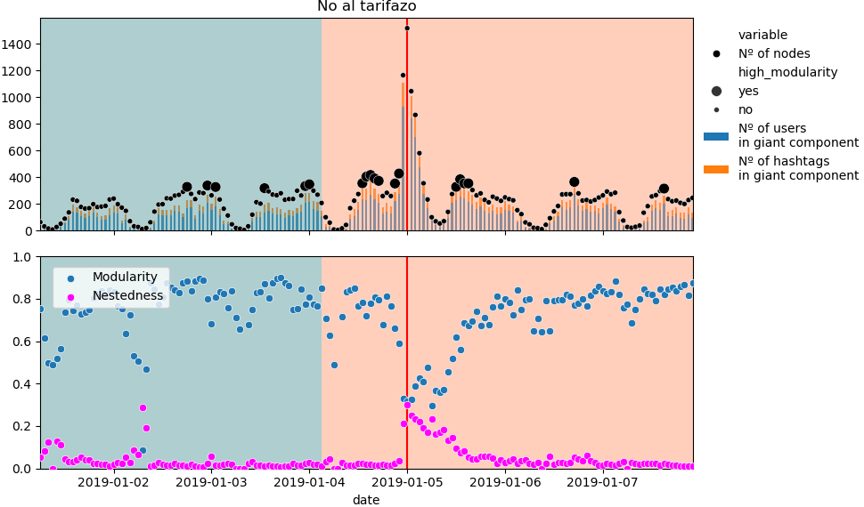
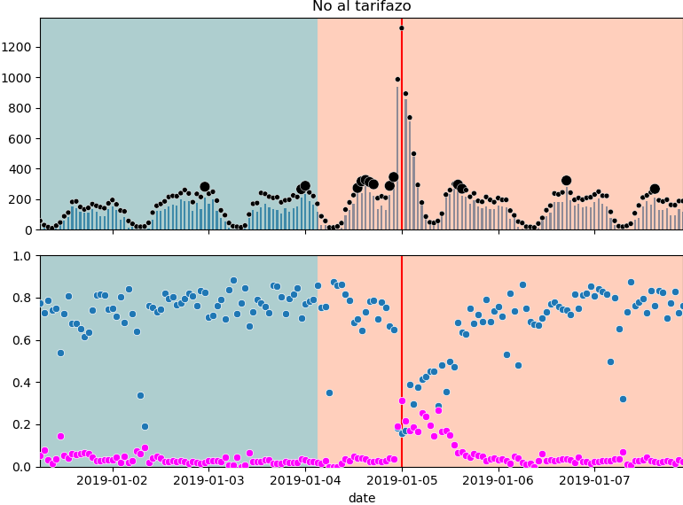
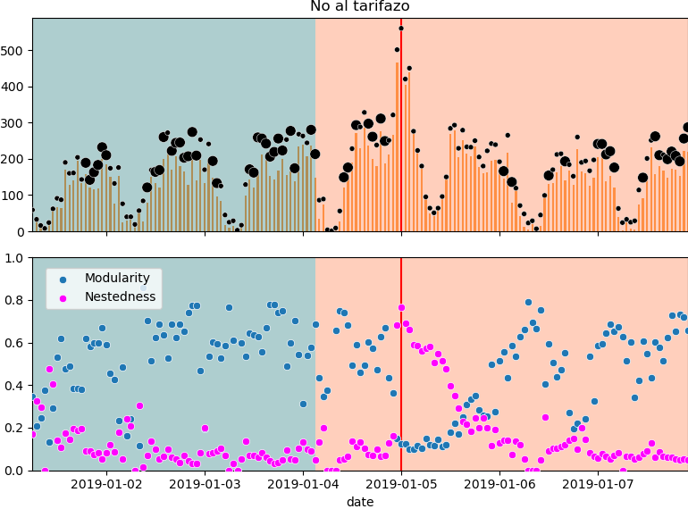
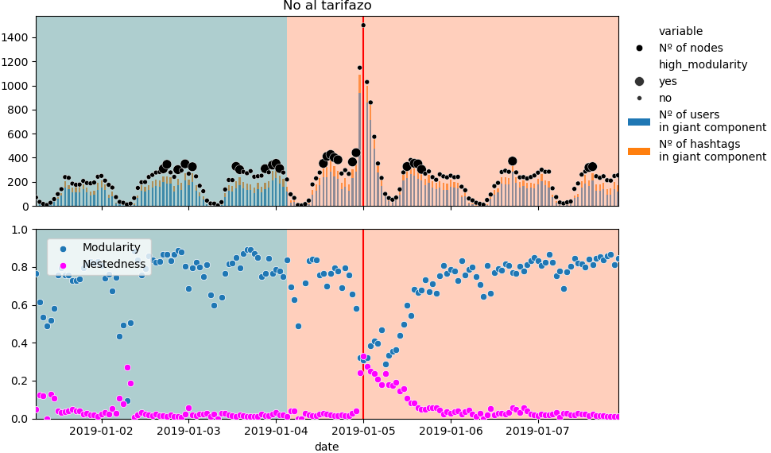
_No al tarifazo_
Before dataset cleaning
Hashtag nodes
User nodes
Bipartite network
After dataset cleaning
High modularity defined by modularity >0.55 and
nr. of nodes in network at least 20% of maximum network size
Hashtag nodes
User nodes
Bipartite network

Slide 4
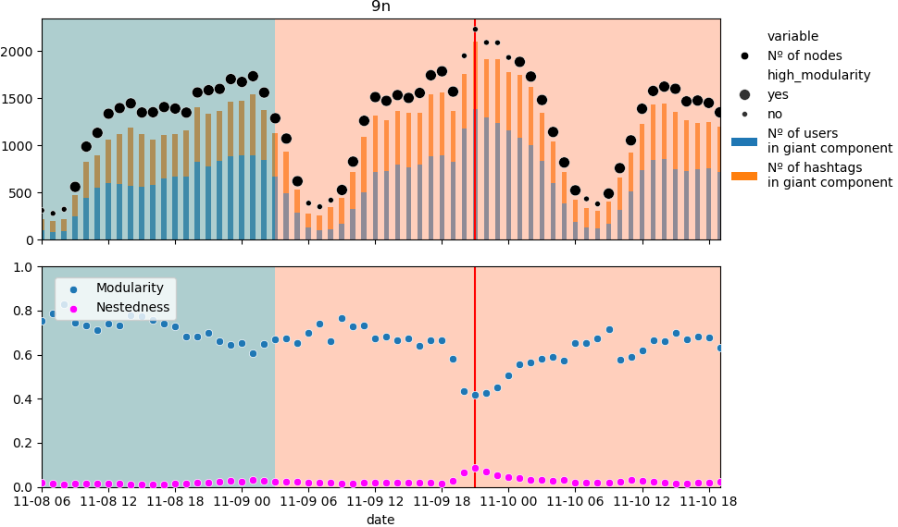
_9 noviembre_
Before dataset cleaning
Hashtag nodes
User nodes
Untrimmed Bipartite network
After dataset cleaning
High modularity defined by modularity >0.55 and
nr. of nodes in network at least 20% of maximum network size
Hashtag nodes
User nodes
Untrimmed Bipartite network

Slide 5
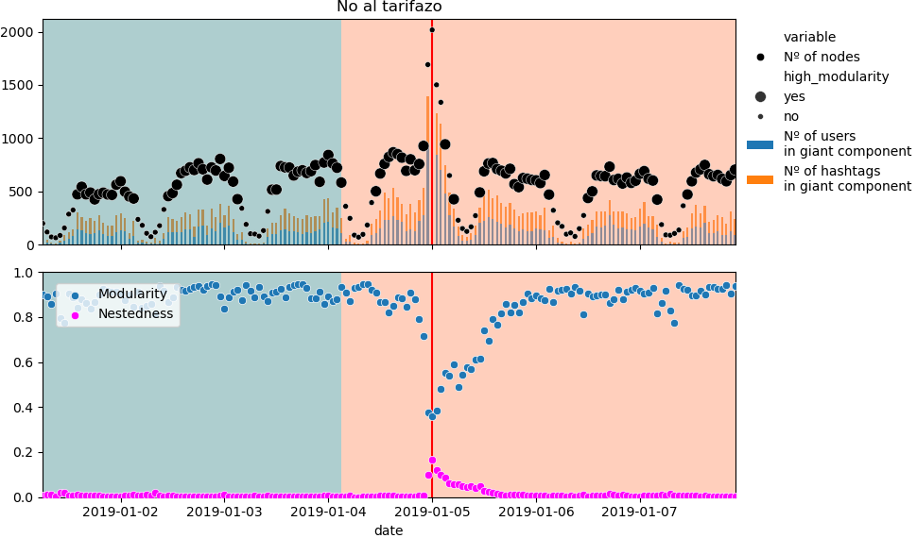
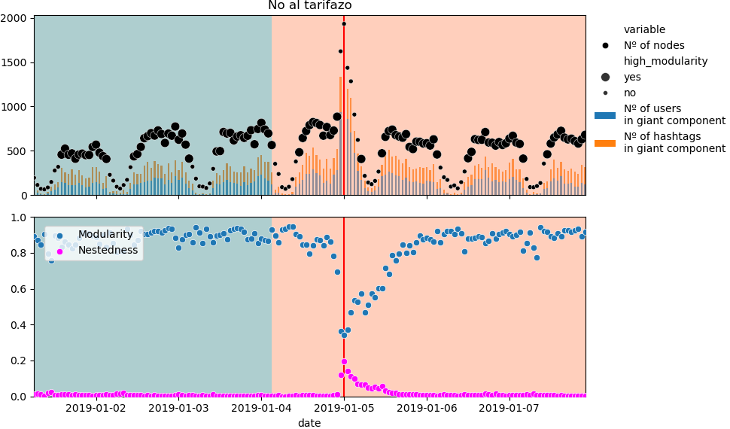
_No al tarifazo_
Before dataset cleaning
Hashtag nodes
User nodes
Untrimmed Bipartite network
After dataset cleaning
High modularity defined by modularity >0.55 and
nr. of nodes in network at least 20% of maximum network size
Hashtag nodes
User nodes
Untrimmed Bipartite network

Slide 6
Node frequency per component
In the following plots we can see how the most important nodes in the critical point behave throughout time.
We can see to how node evolve in the communities throughout time and which nodes from the simple networks are represented in the bipartite networks

Slide 7
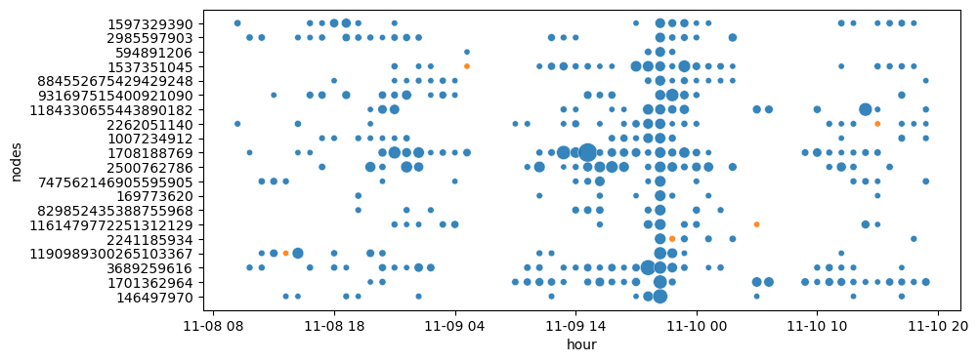
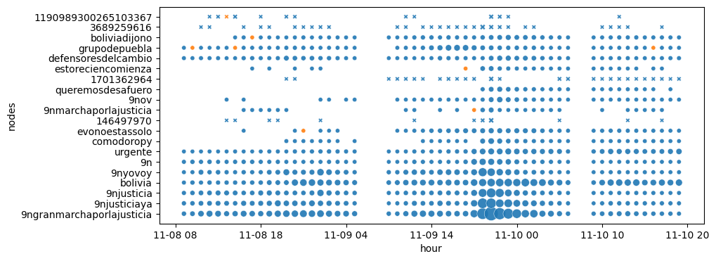
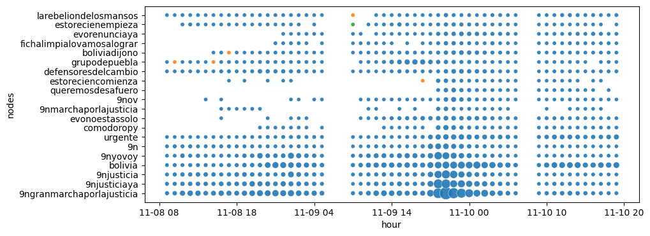
_9n_
Frequency plots of the top 20 nodes in the network with highest nestedness colored by component
User nodes
In the following plots we can see how the most important nodes in the critical point behave throughout time.
We can see to how nodes evolve in the communities throughout time and which nodes from the simple networks are represented in the bipartite networks.
Bipartite network
Nodes in bipartite network
Hashtag nodes
Marker size proportional to frequency.
Limiting display to hours where the nr. of nodes in the bipartite network is at least 15% of its maximum network size to allow comparison across network types
Giant component in blue ( )
In Bipartite network plot:
marker shape – hashtag node (o) or user node (x)

Slide 8
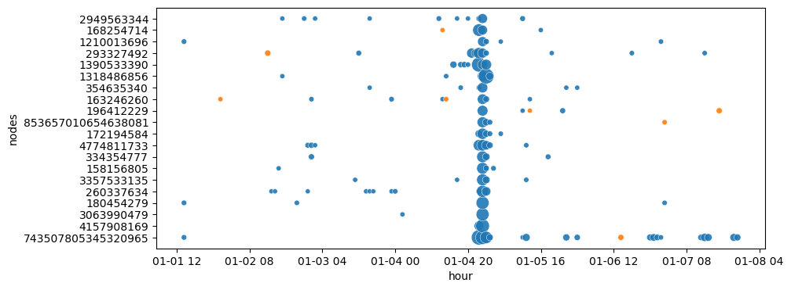
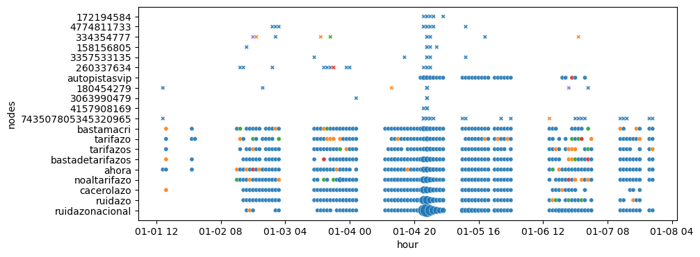
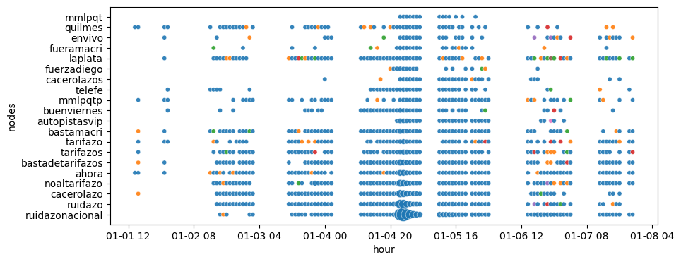
_No al tarifazo_
Frequency plots of the top 20 nodes in the network with highest nestedness colored by component
User nodes
In the following plots we can see how the most important nodes in the critical point behave throughout time.
We can see to how nodes evolve in the communities throughout time and which nodes from the simple networks are represented in the bipartite networks.
Bipartite network
Nodes in bipartite network
Hashtag nodes
Marker size proportional to frequency.
Limiting display to hours where the nr. of nodes in the bipartite network is at least 15% of its maximum network size to allow comparison across network types
Giant component in blue ( )
In Bipartite network plot:
marker shape – hashtag node (o) or user node (x)

Slide 9
_9n_
Frequency plots of the top 20 nodes in the network with highest nestedness colored by component
User nodes
Bipartite network
Nodes in bipartite network
Hashtag nodes

Slide 10
_No al tarifazo_
Frequency plots of the top 20 nodes in the network with highest nestedness colored by component
User nodes
Bipartite network
Nodes in bipartite network
Hashtag nodes

Slide 11
hashtag frequency per component

Slide 12

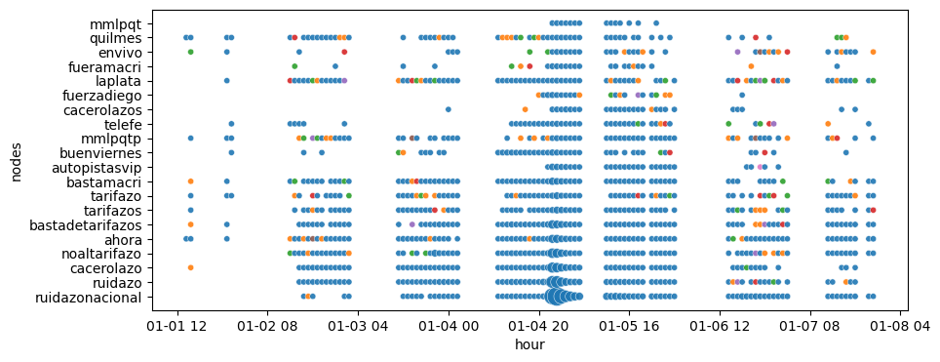
_9n_
Frequency plots of the top 20 hashtags in the network with highest nestedness colored by component
Hashtag nodes
Bipartite network
_No al tarifazo_
Frequency plots of the top 20 hashtags in the network with highest nestedness colored by component
Hashtag nodes
Bipartite network
* Not shown for user node networks because we can’t guarantee that an hashtag belongs to a single component

Slide 13
Node frequency per community
In the following plots we can see how the most important nodes in the critical point behave throughout time.
We can see to how node evolve in the communities throughout time and which nodes from the simple networks are represented in the bipartite networks

Slide 14
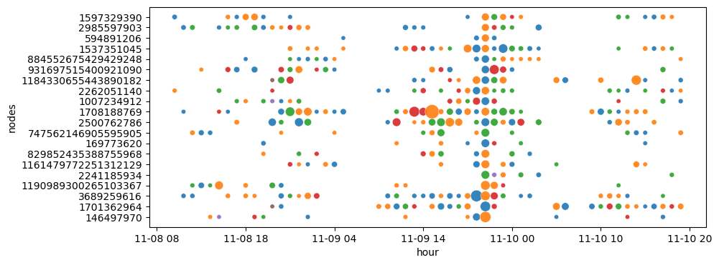
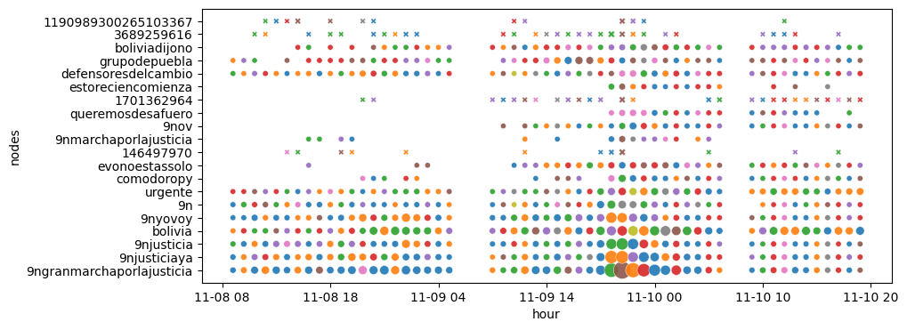
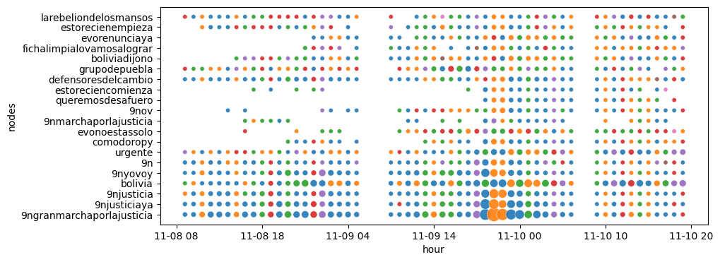
_9n_
Frequency plots of the top 20 nodes in the network with highest nestedness colored by lovain community
User nodes
In the following plots we can see how the most important nodes in the critical point behave throughout time.
We can see to how nodes evolve in the communities throughout time and which nodes from the simple networks are represented in the bipartite networks.
Bipartite network
Nodes in bipartite network
Hashtag nodes
Marker size proportional to frequency.
Limiting display to hours where the nr. of nodes in the bipartite network is at least 15% of its maximum network size to allow comparison across network types
In Bipartite network plot:
marker shape – hashtag node (o) or user node (x)

Slide 15
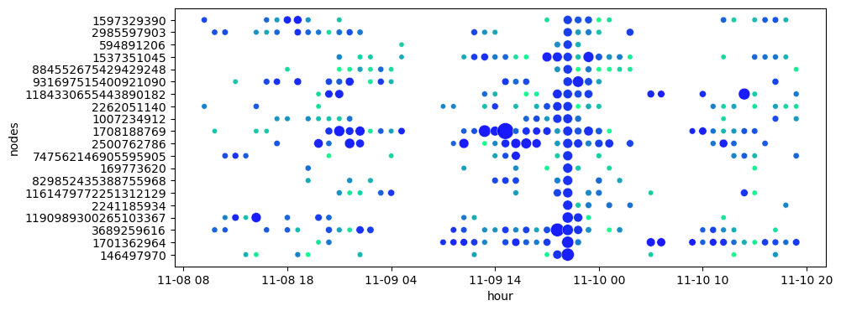
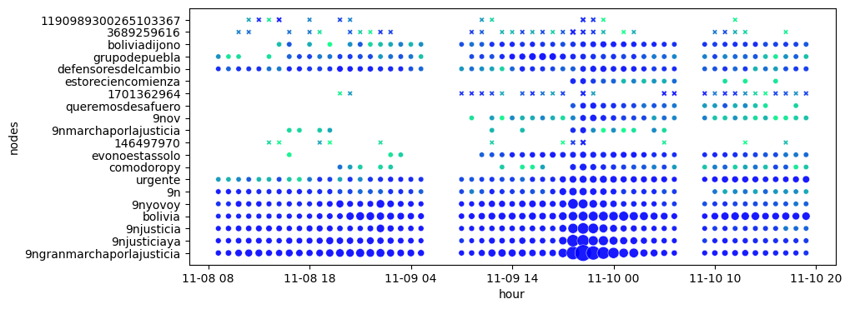
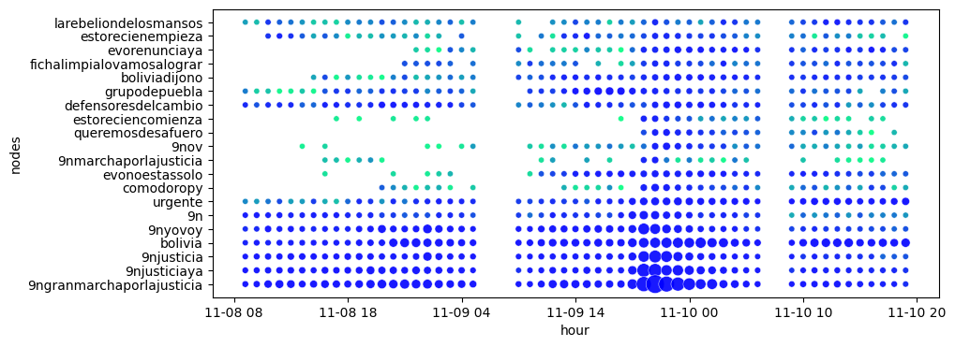
_9n_
Frequency plots of the top 20 nodes in the network with highest nestedness colored by lovain community
User nodes
In the following plots we can see how the most important nodes in the critical point behave throughout time.
We can see to how nodes evolve in the communities throughout time and which nodes from the simple networks are represented in the bipartite networks.
Bipartite network
Nodes in bipartite network
Hashtag nodes
Marker size proportional to frequency.
Limiting display to hours where the nr. of nodes in the bipartite network is at least 15% of its maximum network size to allow comparison across network types
Communities coded by total size rank – ie. organizing the communities according to their size. The, the most blue color will always be the largest community in each hour, and so on.
In Bipartite network plot:
marker shape – hashtag node (o) or user node (x)

Slide 16
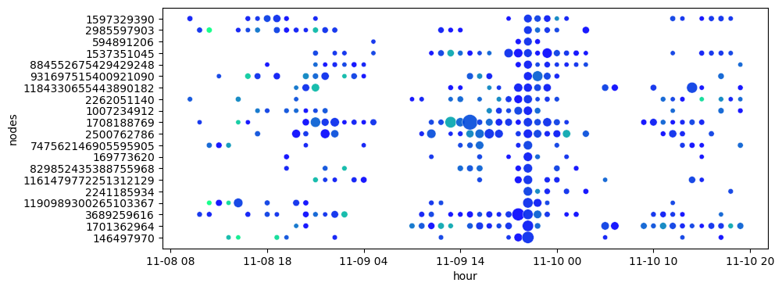
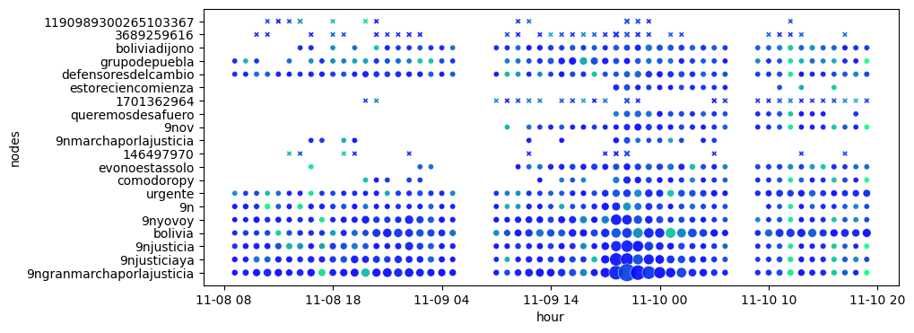
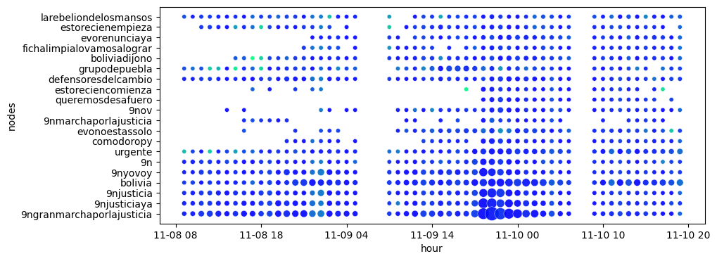
_9n_
Frequency plots of the top 20 nodes in the network with highest nestedness colored by lovain community
User nodes
In the following plots we can see how the most important nodes in the critical point behave throughout time.
We can see to how nodes evolve in the communities throughout time and which nodes from the simple networks are represented in the bipartite networks.
Bipartite network
Nodes in bipartite network
Hashtag nodes
Marker size proportional to frequency.
Limiting display to hours where the nr. of nodes in the bipartite network is at least 15% of its maximum network size to allow comparison across network types
Communities coded by relative size rank – ie. organizing the communities according to their size. The, the most blue color will be the largest community in each hour considering the subset of communities identified by the selected nodes, and so on.
In Bipartite network plot:
marker shape – hashtag node (o) or user node (x)

Slide 17
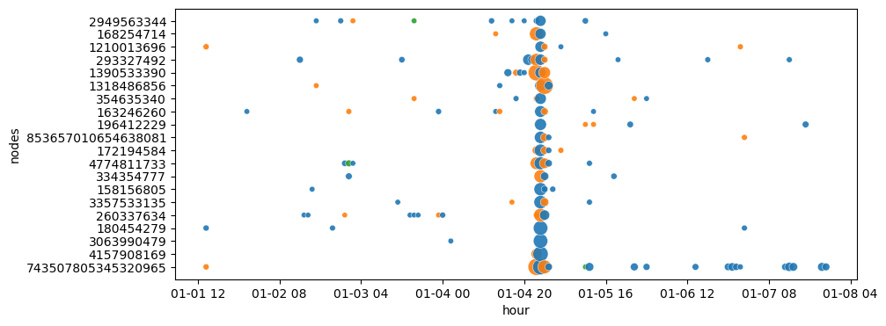
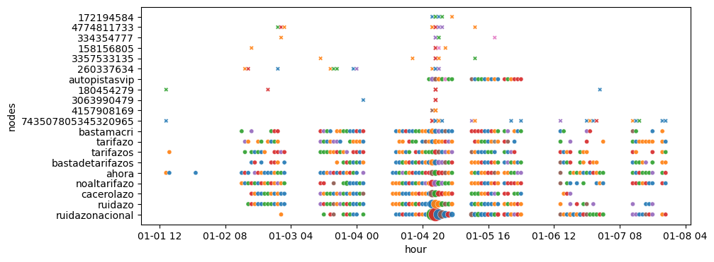
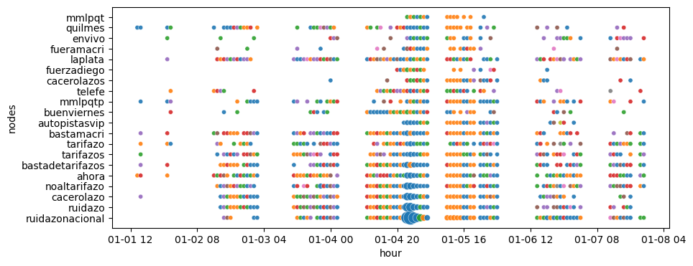
_No al tarifazo_
Frequency plots of the top 20 nodes in the network with highest nestedness colored by lovain community
User nodes
In the following plots we can see how the most important nodes in the critical point behave throughout time.
We can see to how nodes evolve in the communities throughout time and which nodes from the simple networks are represented in the bipartite networks.
Bipartite network
Nodes in bipartite network
Hashtag nodes
Marker size proportional to frequency.
Limiting display to hours where the nr. of nodes in the bipartite network is at least 15% of its maximum network size to allow comparison across network types
In Bipartite network plot:
marker shape – hashtag node (o) or user node (x)

Slide 18
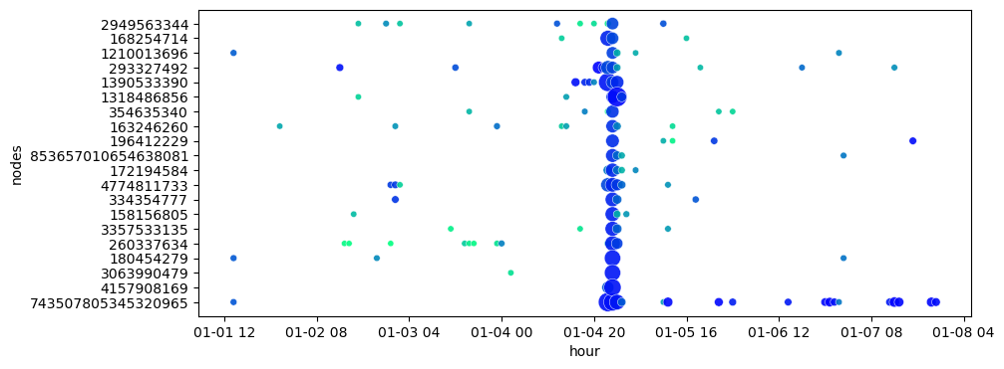
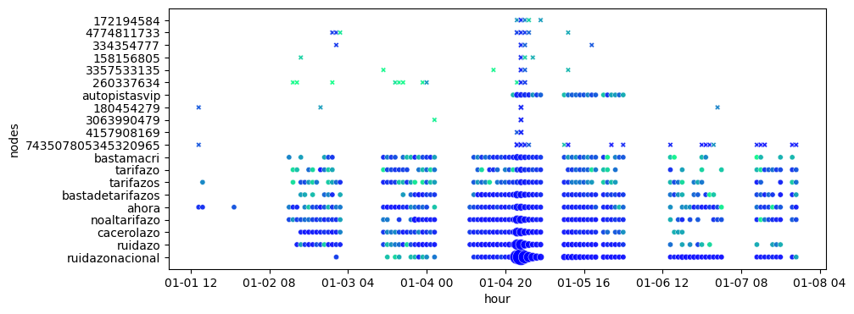
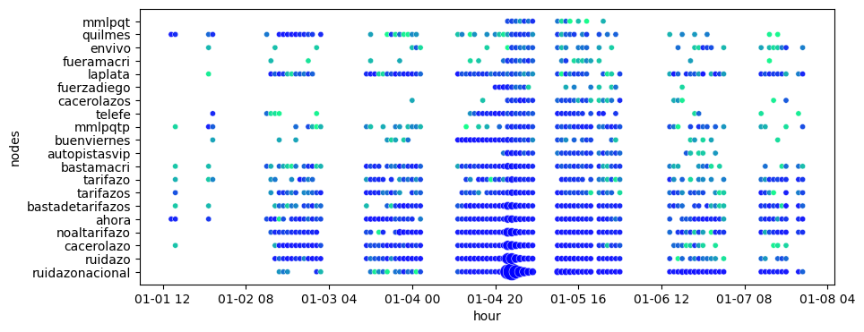
_No al tarifazo_
Frequency plots of the top 20 nodes in the network with highest nestedness colored by lovain community
User nodes
In the following plots we can see how the most important nodes in the critical point behave throughout time.
We can see to how nodes evolve in the communities throughout time and which nodes from the simple networks are represented in the bipartite networks.
Bipartite network
Nodes in bipartite network
Hashtag nodes
Marker size proportional to frequency.
Limiting display to hours where the nr. of nodes in the bipartite network is at least 15% of its maximum network size to allow comparison across network types
Communities coded by total size rank – ie. organizing the communities according to their size. The, the most blue color will always be the largest community in each hour, and so on.
In Bipartite network plot:
marker shape – hashtag node (o) or user node (x)

Slide 19
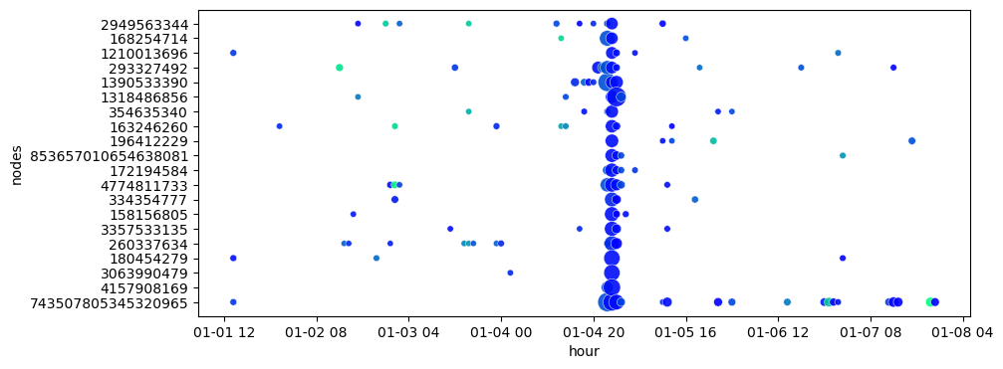
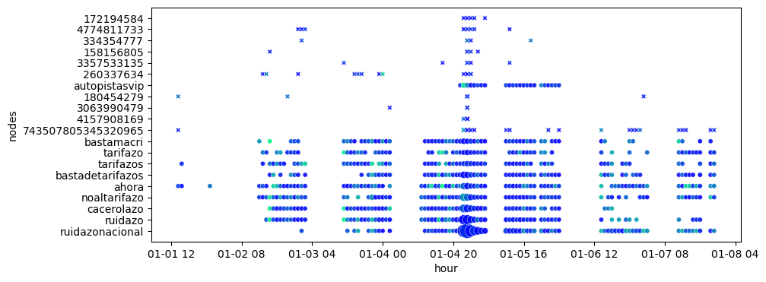
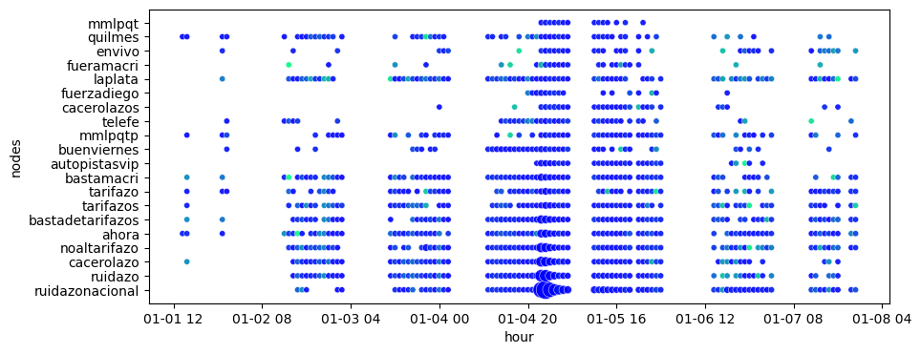
_No al tarifazo_
Frequency plots of the top 20 nodes in the network with highest nestedness colored by lovain community
User nodes
In the following plots we can see how the most important nodes in the critical point behave throughout time.
We can see to how nodes evolve in the communities throughout time and which nodes from the simple networks are represented in the bipartite networks.
Bipartite network
Nodes in bipartite network
Hashtag nodes
Marker size proportional to frequency.
Limiting display to hours where the nr. of nodes in the bipartite network is at least 15% of its maximum network size to allow comparison across network types
Communities coded by relative size rank – ie. organizing the communities according to their size. The, the most blue color will be the largest community in each hour considering the subset of communities identified by the selected nodes, and so on.
In Bipartite network plot:
marker shape – hashtag node (o) or user node (x)

Slide 20
hashtag frequency per community

Slide 21
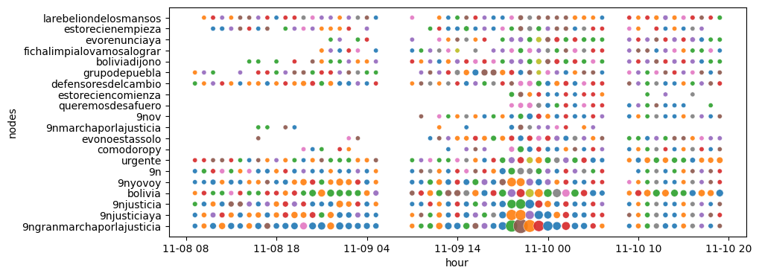
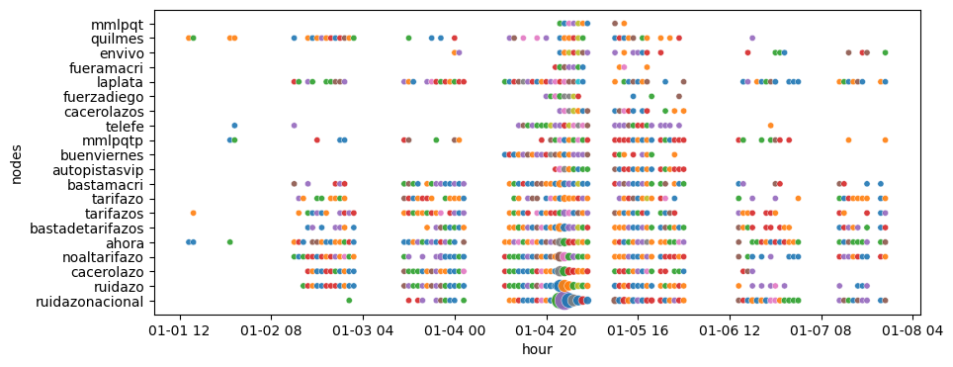
_9n_
Frequency plots of the top 20 nodes in the network with highest nestedness colored by lovain community
Hashtag nodes
Bipartite network
_No al tarifazo_
Frequency plots of the top 20 nodes in the network with highest nestedness colored by lovain community
Hashtag nodes
Bipartite network
* Not shown for user node networks because we can’t guarantee that an hashtag belongs to a single community

Slide 22
Node frequency per “temporal” community
In the following plots we can see how the most important nodes in the critical point behave throughout time.
Temporal communities caluclated with networkx_temporal and flow_stability (not done yet)

Slide 23
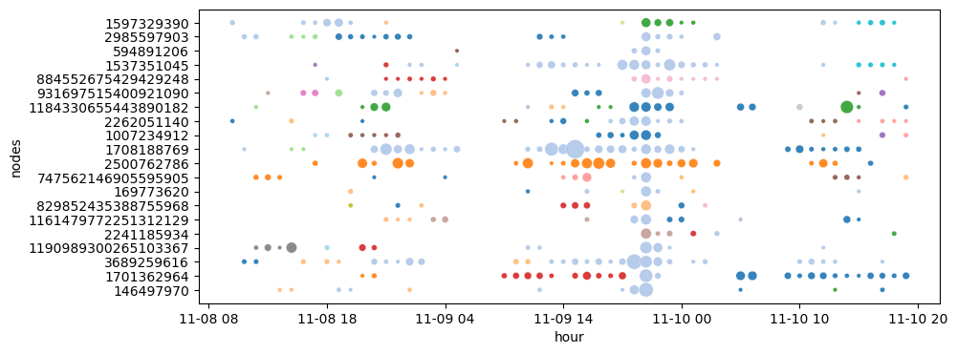
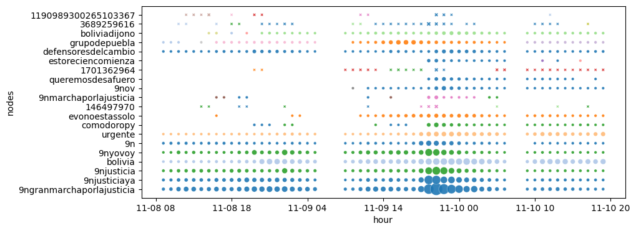
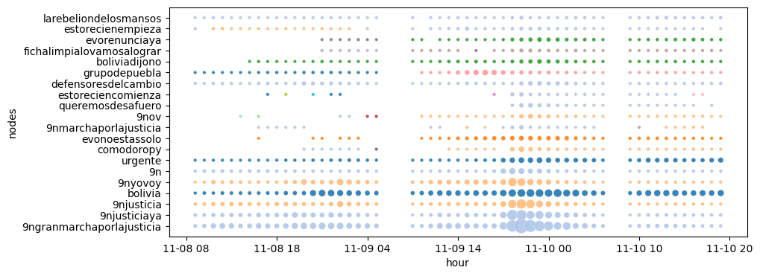
_9n_
Frequency plots of the top 20 nodes in the network with highest nestedness colored by community (networkx_temporal)
User nodes
In the following plots we can see how the most important nodes in the critical point behave throughout time.
We can see to how nodes evolve in the communities throughout time and which nodes from the simple networks are represented in the bipartite networks.
Bipartite network
Nodes in bipartite network
Hashtag nodes
Marker size proportional to frequency.
Limiting display to hours where the nr. of nodes in the bipartite network is at least 15% of its maximum network size to allow comparison across network types
In Bipartite network plot:
marker shape – hashtag node (o) or user node (x)

Slide 24
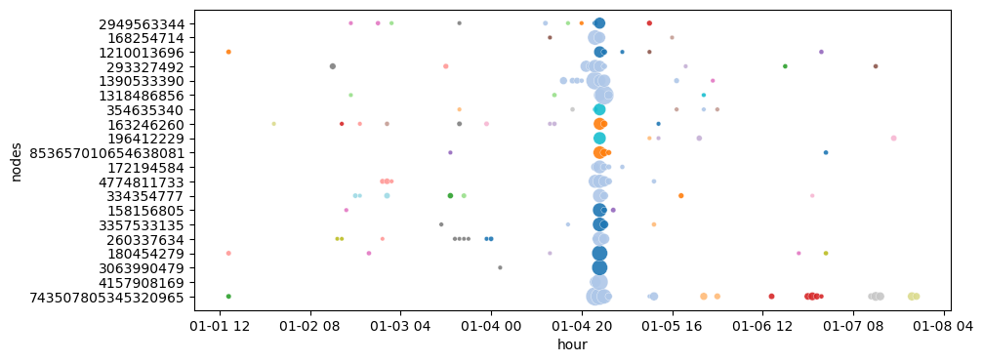
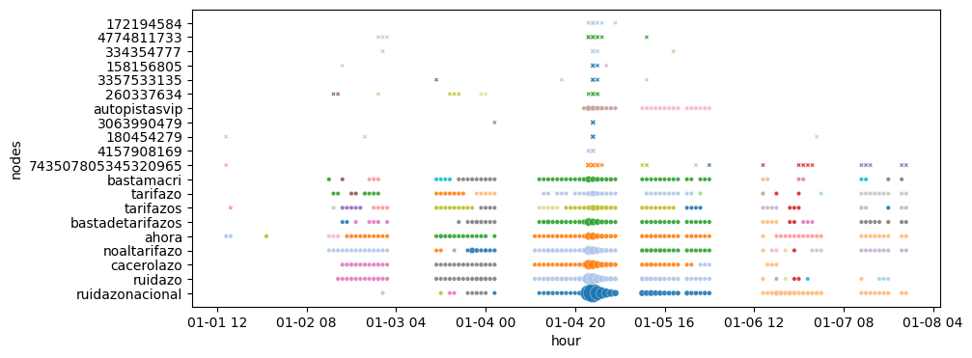
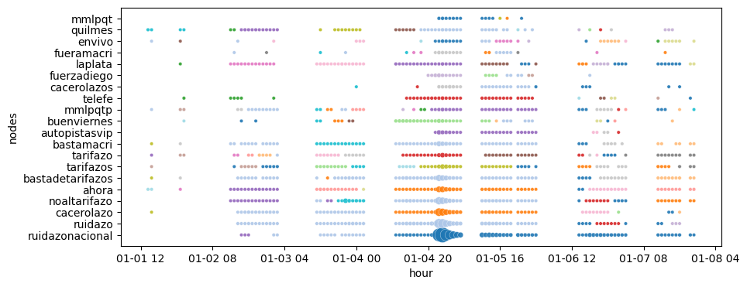
_No al tarifazo_
Frequency plots of the top 20 nodes in the network with highest nestedness colored by community (networkx_temporal)
User nodes
In the following plots we can see how the most important nodes in the critical point behave throughout time.
We can see to how nodes evolve in the communities throughout time and which nodes from the simple networks are represented in the bipartite networks.
Bipartite network
Nodes in bipartite network
Hashtag nodes
Marker size proportional to frequency.
Limiting display to hours where the nr. of nodes in the bipartite network is at least 15% of its maximum network size to allow comparison across network types
In Bipartite network plot:
marker shape – hashtag node (o) or user node (x)

Slide 25
_9n_
Frequency plots of the top 20 nodes in the network with highest nestedness colored by community (networkx_temporal)
User nodes
Bipartite network
Nodes in bipartite network
Hashtag nodes

Slide 26
_No al tarifazo_
Frequency plots of the top 20 nodes in the network with highest nestedness colored by community (networkx_temporal)
User nodes
Bipartite network
Nodes in bipartite network
Hashtag nodes

Slide 27
Node Centrality

Slide 28
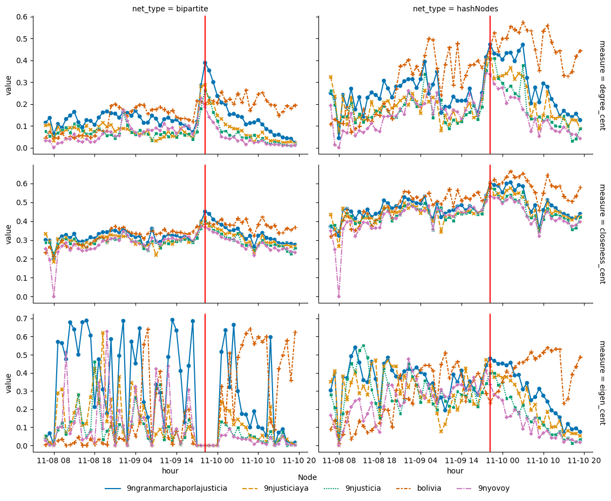
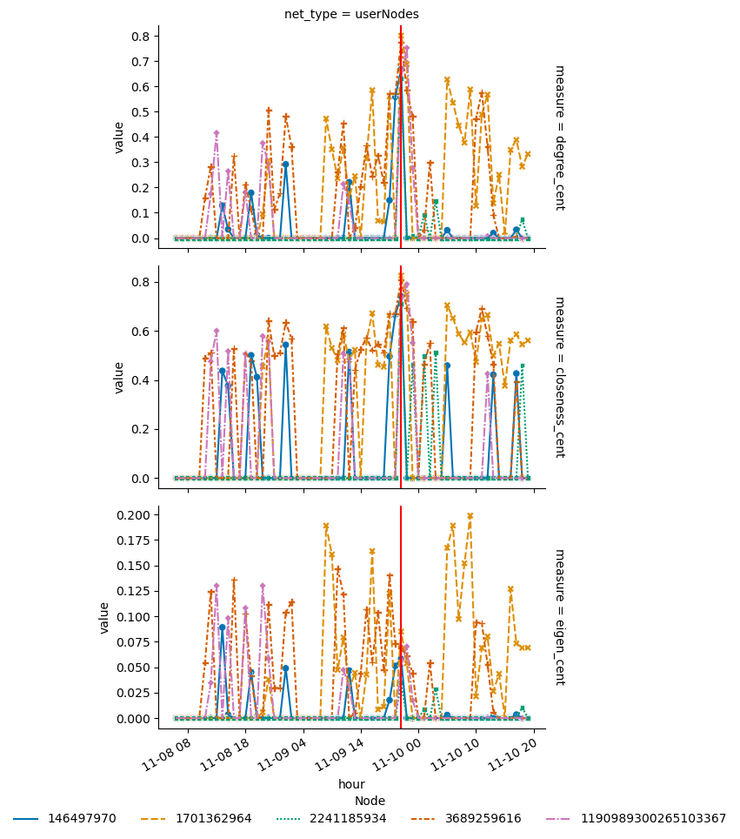
_9n_
Centrality measure of the top 5 most frequent nodes in the network with highest nestedness

Slide 29
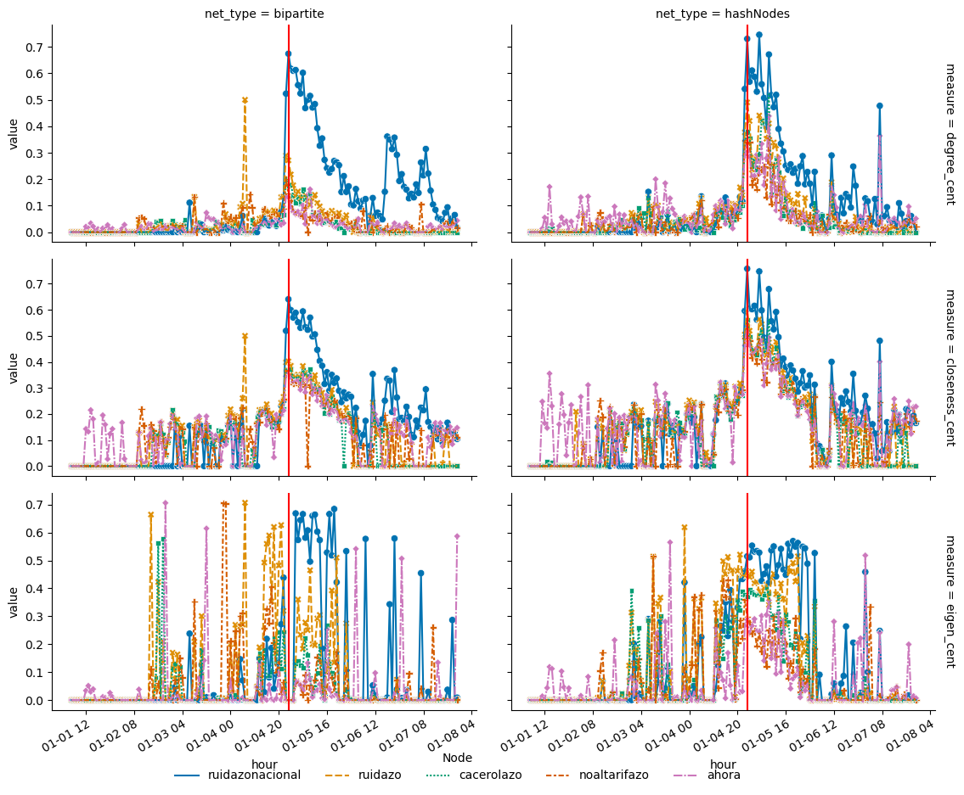

_No al tarifazo_
Centrality measure of the top 5 most frequent nodes in the network with highest nestedness

Slide 30
Node Centrality
with largest centrality value per hour
Notes:
Degree Centrality: measures how many direct connections (or edges) a node has.
Clustering Centrality: reflects how close a node's neighbors are to forming a complete clique (where every node is connected to every other node).
Eigenvector Centrality: measures the influence of a node based on how connected its neighbors are and how influential those neighbors are
Betweenness Centrality: measures how often a node acts as a bridge along the shortest path between two other nodes.

Slide 31


_9n_
Centrality measure of the top 5 most frequent nodes in the network with highest nestedness

Slide 32
_No al tarifazo_
Centrality measure of the top 5 most frequent nodes in the network with highest nestedness

Slide 33
Node Centrality
Calculated for giant component subgraph
Notes:
Degree Centrality: measures how many direct connections (or edges) a node has.
Clustering Centrality: reflects how close a node's neighbors are to forming a complete clique (where every node is connected to every other node).
Eigenvector Centrality: measures the influence of a node based on how connected its neighbors are and how influential those neighbors are
Betweenness Centrality: measures how often a node acts as a bridge along the shortest path between two other nodes.

Slide 34


_9n_
Centrality measure of the top 5 most frequent nodes in the network with highest nestedness

Slide 35


_No al tarifazo_
Centrality measure of the top 5 most frequent nodes in the network with highest nestedness

Slide 36
Node Centrality
Calculated for giant component subgraph
with largest centrality value per hour
Notes:
Degree Centrality: measures how many direct connections (or edges) a node has.
Clustering Centrality: reflects how close a node's neighbors are to forming a complete clique (where every node is connected to every other node).
Eigenvector Centrality: measures the influence of a node based on how connected its neighbors are and how influential those neighbors are
Betweenness Centrality: measures how often a node acts as a bridge along the shortest path between two other nodes.

Slide 37


_9n_
Centrality measure of the top 5 most frequent nodes in the network with highest nestedness

Slide 38


_No al tarifazo_
Centrality measure of the top 5 most frequent nodes in the network with highest nestedness

Slide 39
PageRank

Slide 40




_9n_
Pagerank of the top 5 most frequent nodes in the network with highest nestedness
_No al tarifazo_
Pagerank of the top 5 most frequent nodes in the network with highest nestedness

Slide 41
Main K-core
Size, edge and node connectivity
(por terminar)
Notes:
Main k-core is the maximal subgraph with the largest degree
Should probably calculate the degree

Slide 42

Nr. of nodes and node connectivity in main k-core

Slide 43

Nr. of edges and edge connectivity in main k-core

Slide 44

Nr. of nodes and node connectivity in main k-core

Slide 45

Nr. of edges and edge connectivity in main k-core

Slide 46
Hashtag freq. plots & Cluster-size distribution
For point of high nestedness

Slide 47




Hashtag frequency plots (top) and Cluster-size distribution in highest nestedness hour

Slide 48


Hashtag frequency plots (top) and Cluster-size distribution (after removing nodes with freq < 2) in highest nestedness hour

Slide 49

Cluster-size entropy
Calculated as,
where s is the cluster (or community) size and P_{s} is the probability of belonging to a cluster of size s

Slide 50


Cluster size entropy across time

Slide 51


Cluster size entropy across time (after removing nodes with freq < 2)

